Slide 1
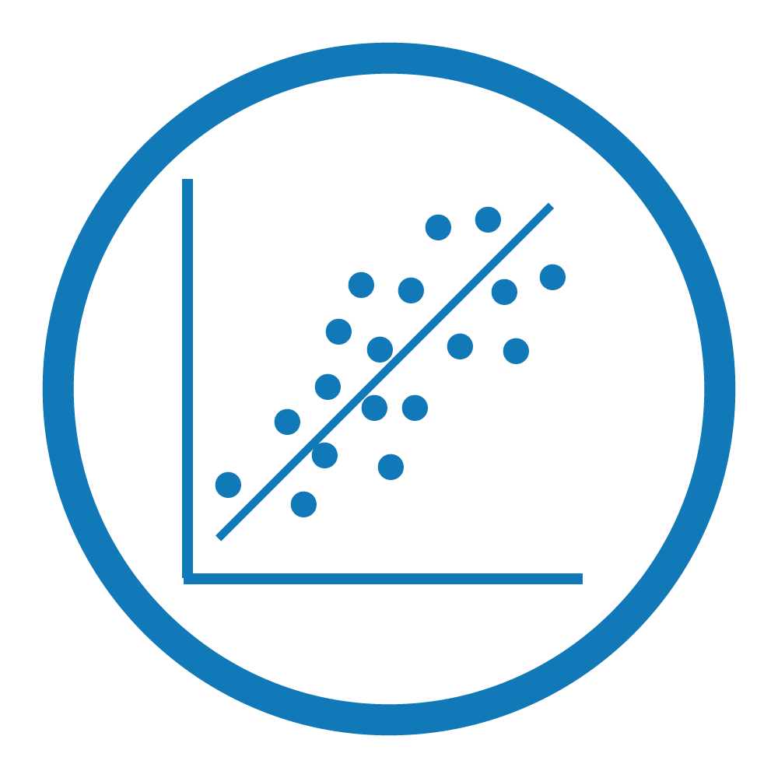
Linear
Regression
Abhilash Datta
Divyangna Sharma

Slide 2
Variables
Categorical
Values that can be organized into categories (not numerical)
Example : Color of Fruit
Quantitative
Numerical values for which arithmetic operations make sense
Example : Prices
Ordinal
Variables for which the possible values are ordered
Example : Education Level

Slide 3
Variables (Contd.)
Features
Individual independent variables that act as the input in your system
Example: Area, #rooms, garden, garage & location can be the features for a House Pricing Dataset
Target
It’s the output or the “label” for the input variables
Example: Price of a House for a House Pricing Dataset

Slide 4
A Typical labelled Dataset
 | x₁ | x₂ | y
1 | 10 | Y | 7
2 | ? | N | 10
3 | 5 | ? | 16

Slide 5

Data Preprocessing
Machines cannot interpret raw data directly
Data Preprocessing is that step in which the data gets transformed, or encoded, to such a state that machine can easily parse it
Data Imputation, feature scaling and Label encoding are part of Data Preprocessing

Slide 6
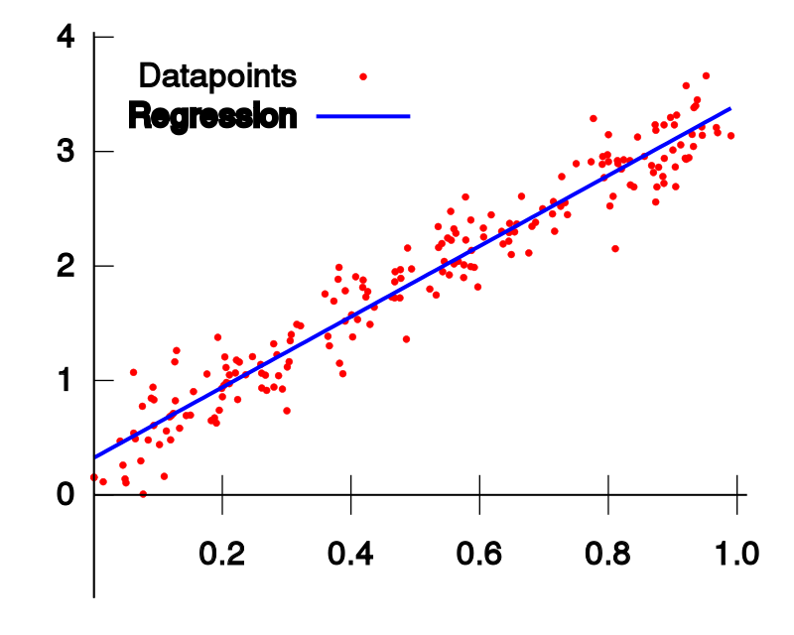
Linear Regression
What is Linear?
What is Regression?

Slide 7
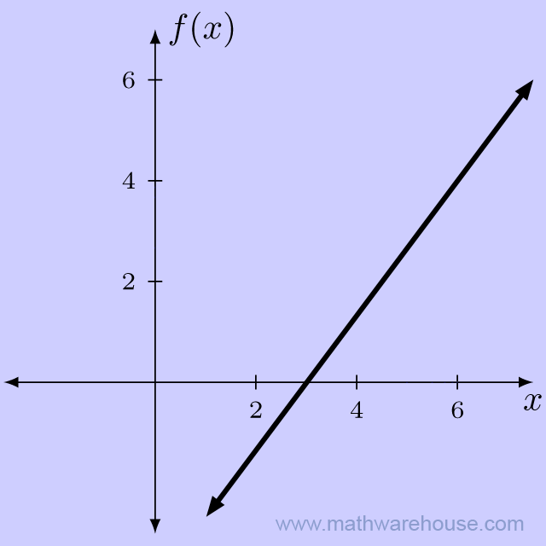
What is “Linear”?
y = 2.15x?
y = w₀x₀+ w₁x₁ + w₂x₂+.....+ w_{n}x_{n}
y ∝ x_{i} ∀i ∊ [0 , n]
All x_{i}’s are attributes and w_{i}’s are called weights
A linear curve is a curve that has a linear dependence on the curve parameters.

Slide 8
What is “Regression”?
Statistical method that attempts to determine the strength of the relationship between one dependent variable and a series of other independent variables.
It's used to predict values within a continuous range, (e.g. sales, price) rather than trying to classify them into categories (e.g. cat, dog).

Slide 9
Linear Regression
Linear Regression is a supervised machine learning algorithm where the predicted output is continuous and has a constant gradient.
Linear regression algorithm shows a linear relationship between a dependent (y) and one or more independent (x) variables.
Univariate Linear Regression and Multivariate Linear Regression

Slide 10
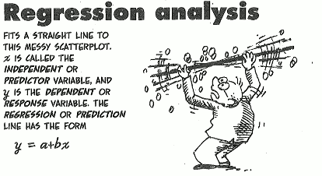

Slide 11
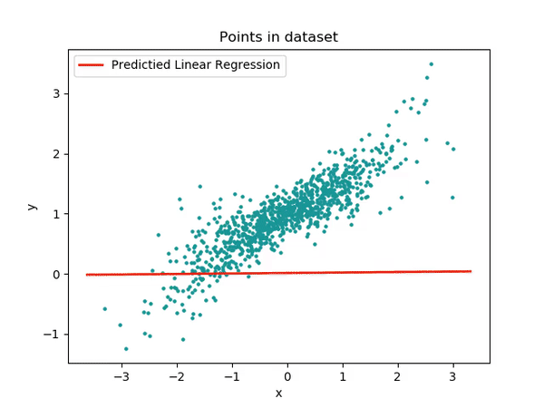

Slide 12
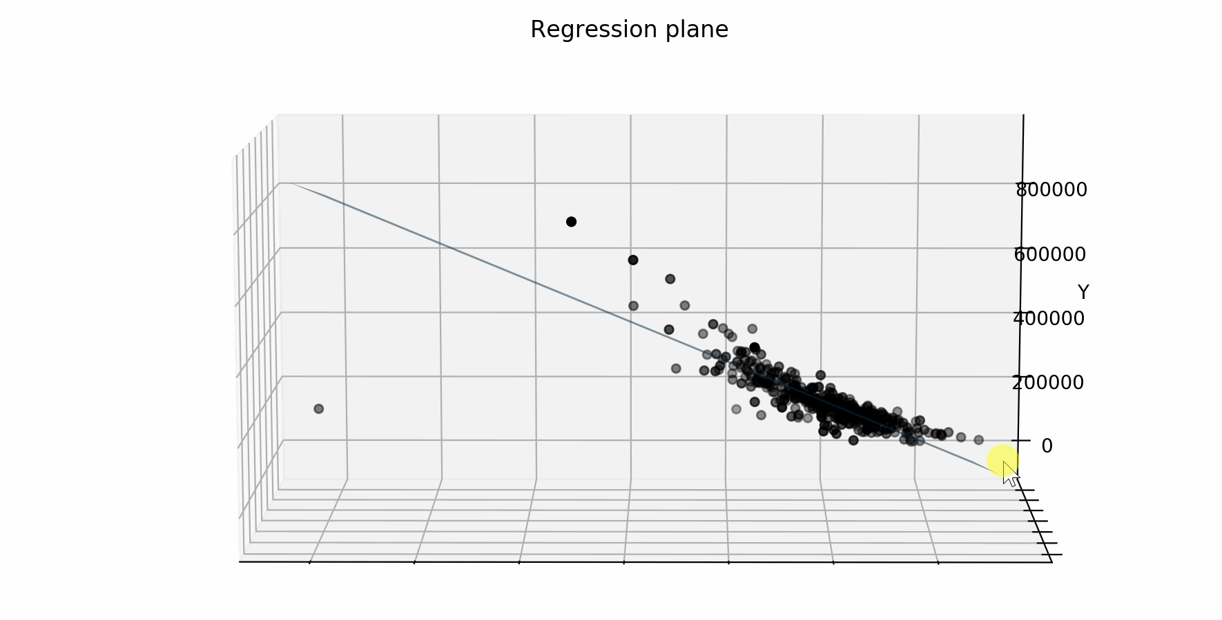

Slide 13
Hypothesis
A hypothesis is a candidate model that approximates a target function for mapping inputs to outputs.
Mathematically,
f : X^{n} ⇾ Y
Where X is the set of attributes and Y is the set of labels
h_{ፀ}≈ f
For linear regression hypothesis looks like-
h_{ፀ}(x₀,x₁…,x_{n}) = θ₀x₀+ θ₁x₁+ θ₂x₂+...........+ θ_{n}x_{n}

Slide 14
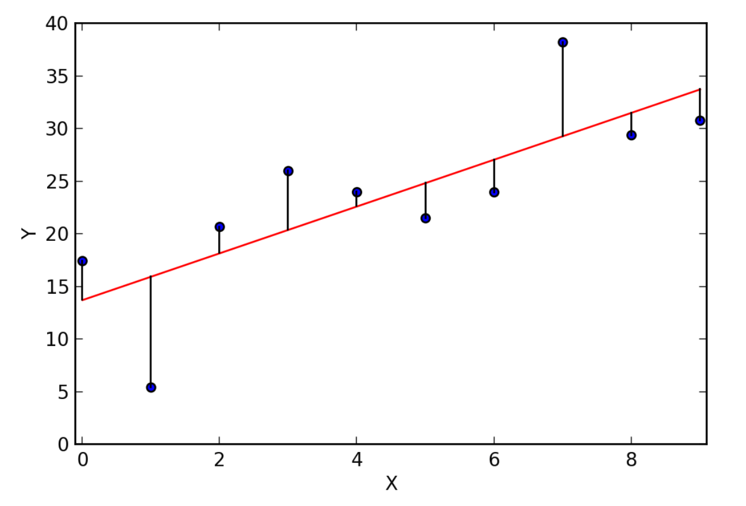
Residual Error
A residual is the vertical distance between a data point and the regression plane.
Basically, it’s the difference between the predicted value (h_{ፀ}(x)) and the observed value (y).
e = |y - h_{ፀ}(x)|

Slide 15
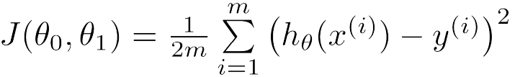
Cost Function
Cost Function quantifies the error between predicted values and expected values
Cost Function for Univariate Linear Regression is basically Mean Squared Error:
where x^{(i)} is the input for i^{th} training example and y^{(i)} is the output and m is the total no. of training examples

Slide 16

Goal: To minimize the cost function to improve the accuracy of our model.

Slide 17
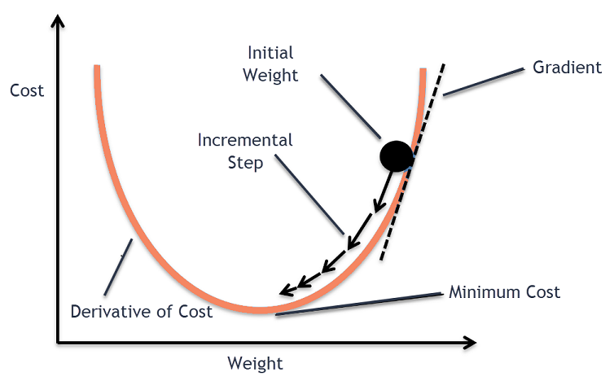
Gradient Descent

Slide 18
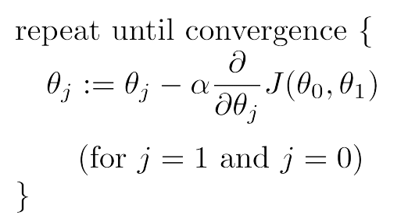
Gradient Descent
First Order Optimization algorithm used to minimize the cost function by iteratively moving in the direction of steepest descent as defined by the negative of the gradient.
Algorithm:
where α is called the Learning Rate.

Slide 19
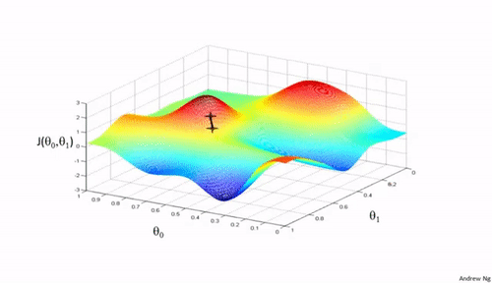
Gradient descent in progress

Slide 20

Dependence on Initial weights

Slide 21
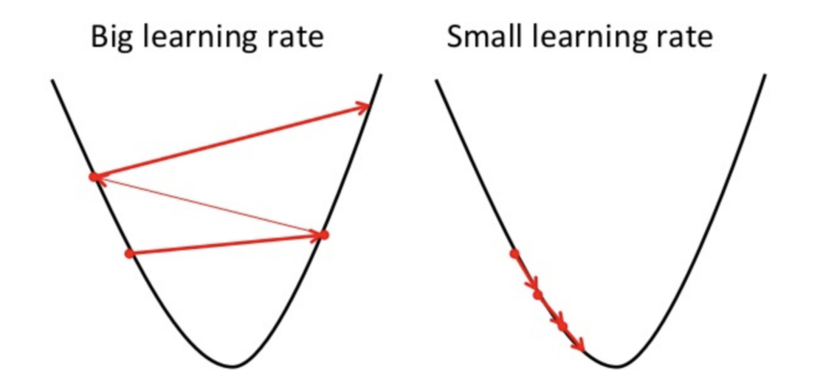
Effect of Learning Rate
The learning rate is a hyperparameter that controls how much to change the model in response to the estimated error each time the model weights are updated.

Slide 22
Fitting of Model
LOW BIAS
LOW VARIANCE
GOOD FIT

Slide 23
Underfitting
A model is said to have underfitting when it’s unable to capture the true relationship and underlying trend of the data.
The model is said to have High Bias.
Underfitting results in low accuracy in both training and testing datasets.

Slide 24
Overfitting
A model is said to have overfitting if it fits the training data too well and captures the noise of training data.
The model is said to have High Variance
Overfitting results in high accuracy in training data but less accuracy in testing data.

Slide 25
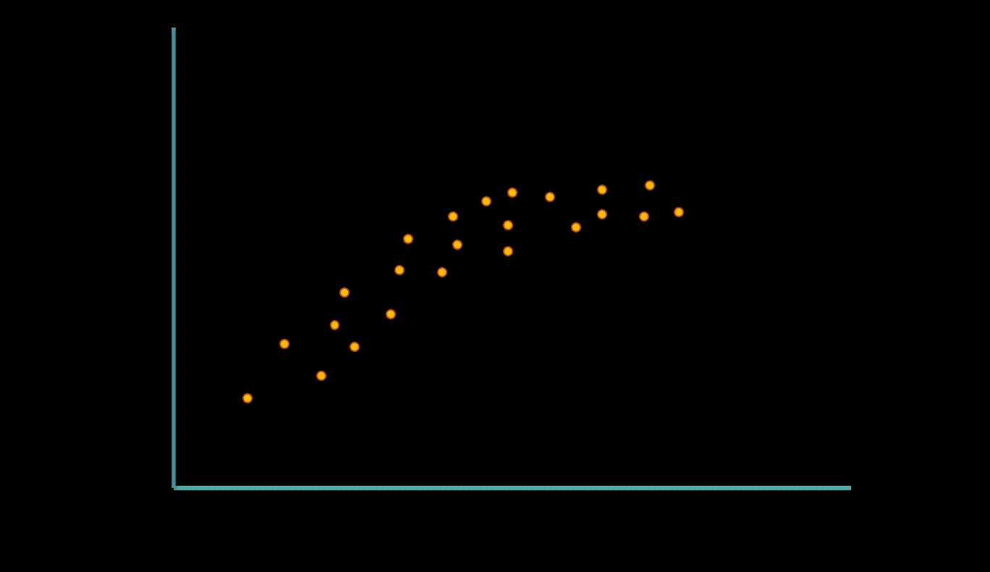

Slide 26
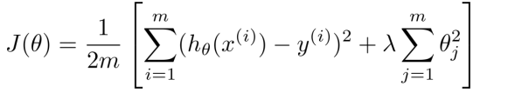
Regularization
Regularization is the method to estimate a preferred complexity of the machine learning model so that the model generalizes and the overfitting problem is avoided.
We keep the same number of features, but reduce the magnitude of the coefficients
where λ is the Regularization parameter

Slide 27
Lasso and Ridge
Lasso
Regularization term:
λ ∑ | θ_{j} |
It penalizes the sum of absolute values of the coefficients.
(L1 penalty)
Ridge
Regularization term:
λ ∑ θ_{j}²
It penalizes sum of squared coefficients.
(L2 penalty)
n
n
j=1
j=1

Slide 28
THANKS!

